Slide 1
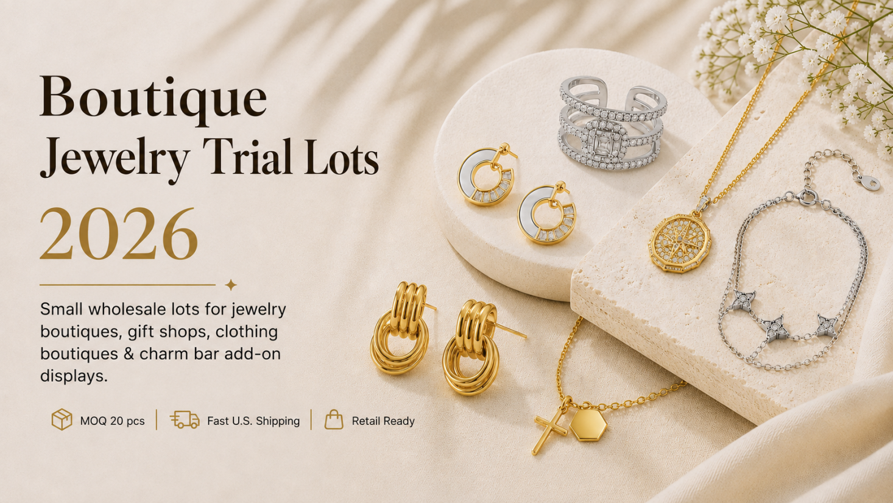

Slide 2
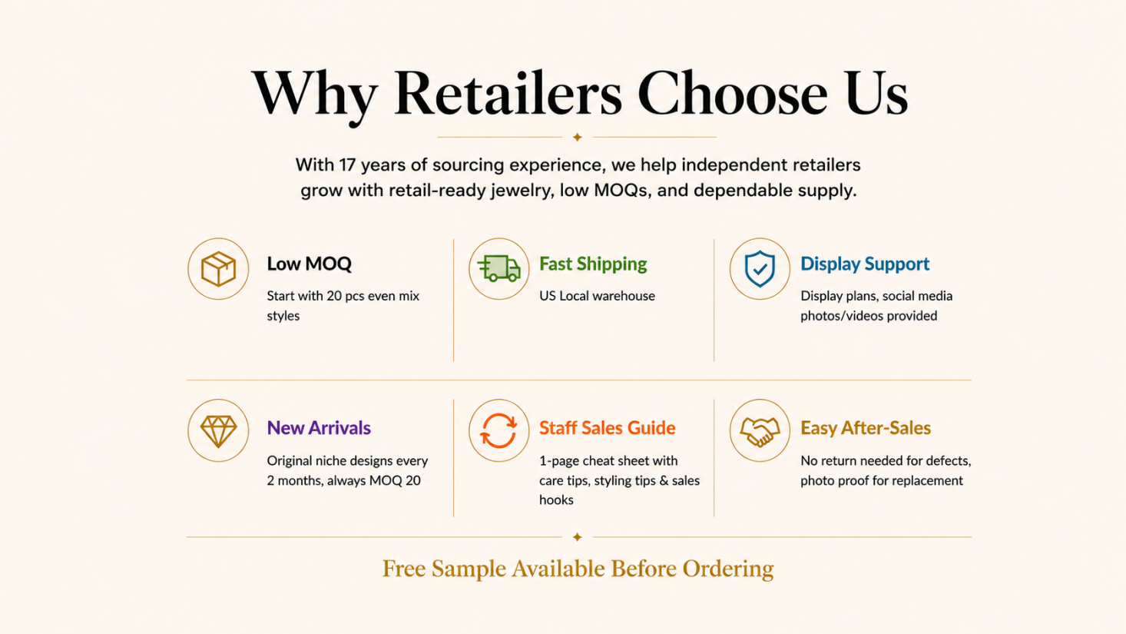

Slide 3
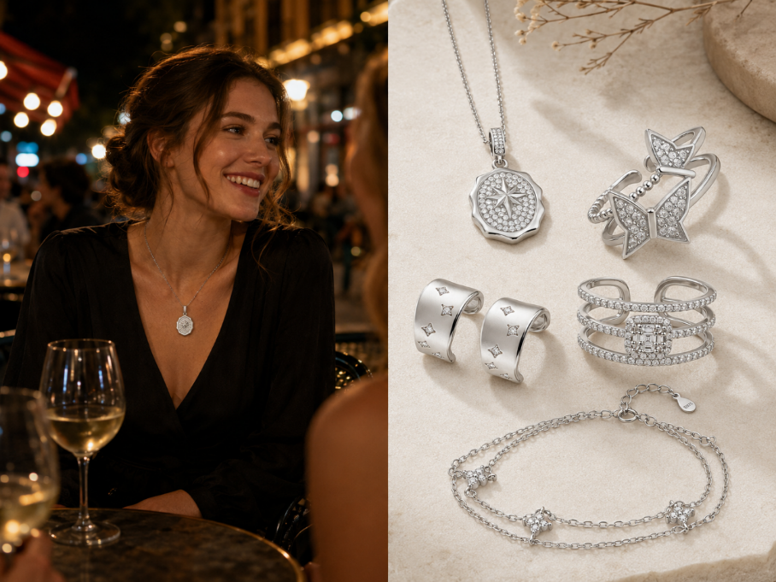
"Starlight Mix" Set Set Includes: 20 Pcs Total，5 Styles × 4 Pcs Each Retail Opportunity: Suggested Retail Price：$15.99–$27.99 per piece Your Wholesale Cost：$2.7–$5.30 per piece Materials: 5-Layer 18K Premium Plating 5A Cubic Zirconia & Hypoallergenic Waterproof & Sweat-proof Adjustable Size: Rings: US 6-8 Open Ring Fit Bracelet: 6.5"+1" Extender Necklace: 15"-17" Occasions: Day-to-Night Styling & Sliver Lover Packaging: Chic gift box

Slide 4
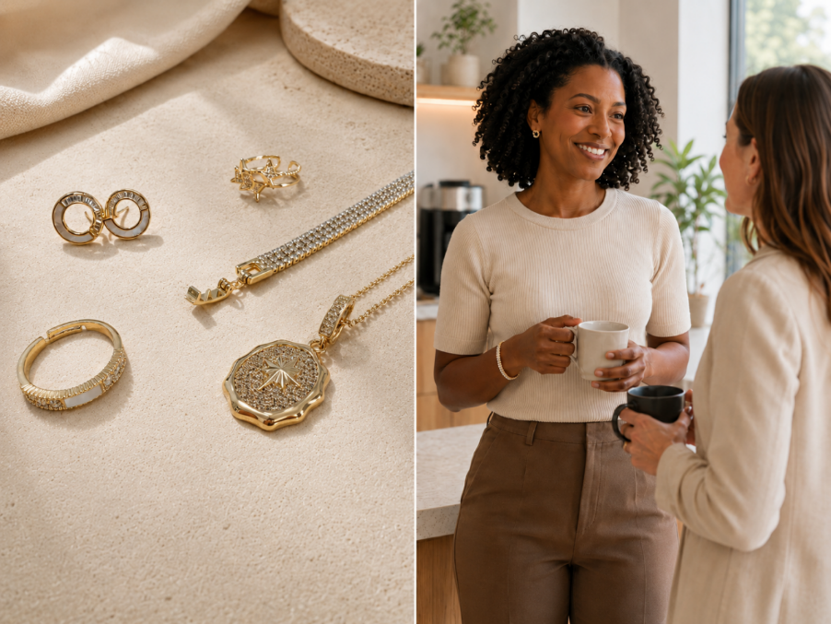
“Golden Hour”Set Set Includes: 20 Pcs Total，5 Styles × 4 Pcs Each Retail Opportunity: Suggested Retail Price：$14.99–$27.99 per piece Your Wholesale Cost：$2.7–$4.7 per piece Materials: 5-Layer 18K Premium Plating 5A Cubic Zirconia & Hypoallergenic Waterproof & Sweat-proof Adjustable Size: Rings: US 6-8 Open Ring Fit Bracelet: 7.1" base + 0.4" extender Necklace: 15"-17" Occasions: Day-to-Night Styling & Gold lover Packaging: Chic gift box

Slide 5
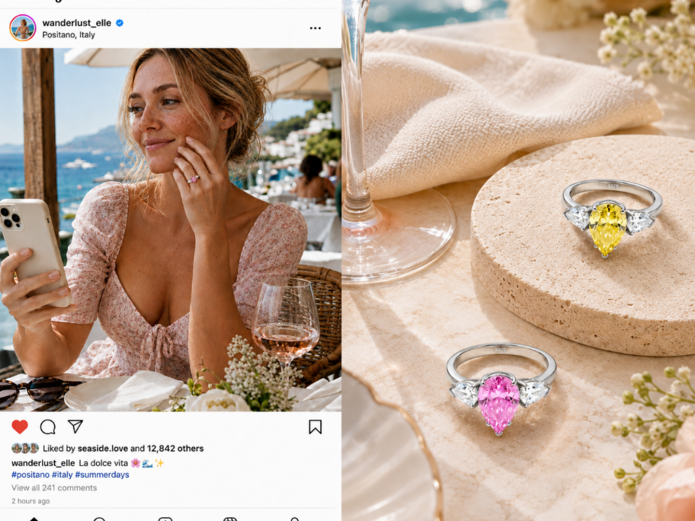
“Sugar Ring”Set Set Includes: 10 Pcs Total，2 Styles × 5 Pcs Each Retail Opportunity: Suggested Retail Price：$79.99–$119.99 per piece Your Wholesale Cost：$16.9–$19.8 per piece Materials: Solid 925 sterling silver 5A cubic zirconia sparkle 5-layer premium 18K plating Waterproof & Sweat-proof Size: Rings: US 6 & US 7 Occasions: Engagement style & Daily wear & IG style Packaging: Premium LED light box Best For: Boutique display / Charm bar add-on / Gift corner / Clothing store add-on

Slide 6
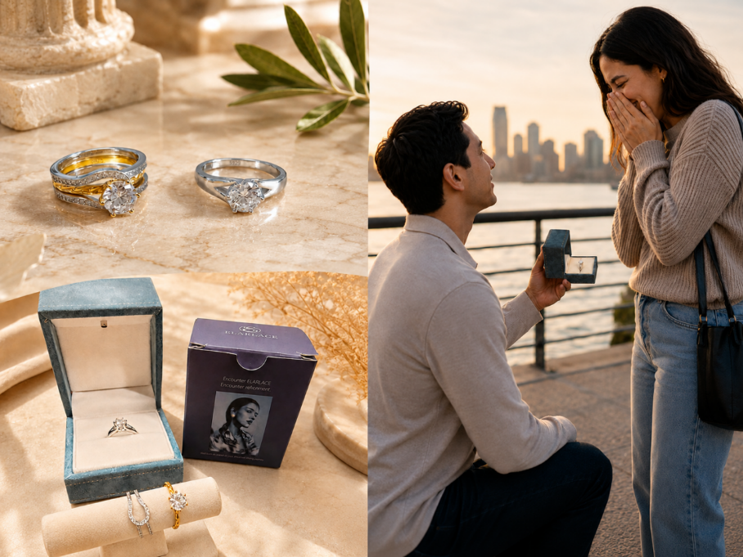
“Mood Ring”Set Set Includes: 10 Pcs Total，2 Styles × 5 Pcs Each Retail Opportunity: Suggested Retail Price：$79.99–$119.99 per piece Your Wholesale Cost：$16.9–$19.8 per piece Materials: Solid 925 sterling silver 5A cubic zirconia sparkle 5-layer premium 18K plating Waterproof & Sweat-proof Size: Rings: US 6 & US 7 Occasions: Engagement style & Daily wear Packaging: Premium LED light box Best For: Boutique display / Charm bar add-on / Gift corner / Clothing store add-on

Slide 7
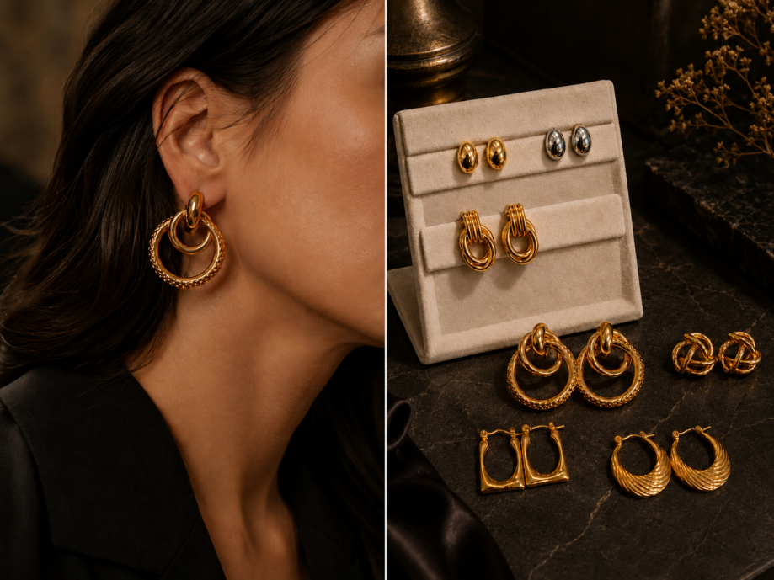
“Chic Ears” Set Set Includes: 30 Pcs Total 5 Styles × 4 Pcs Each + 2 Styles × 5 Pcs Each Retail Opportunity: Suggested Retail Price：$13.99–$25.99 per piece Your Wholesale Cost：$2.7–$3.3 per piece Materials: 5-Layer 18K Premium Plating Waterproof & Sweat-proof Occasions: Workdays, Dates, and Parties Classic design Packaging: Chic gift box Best For: Boutique display / Charm bar add-on / Gift corner / Clothing store add-on

Slide 8
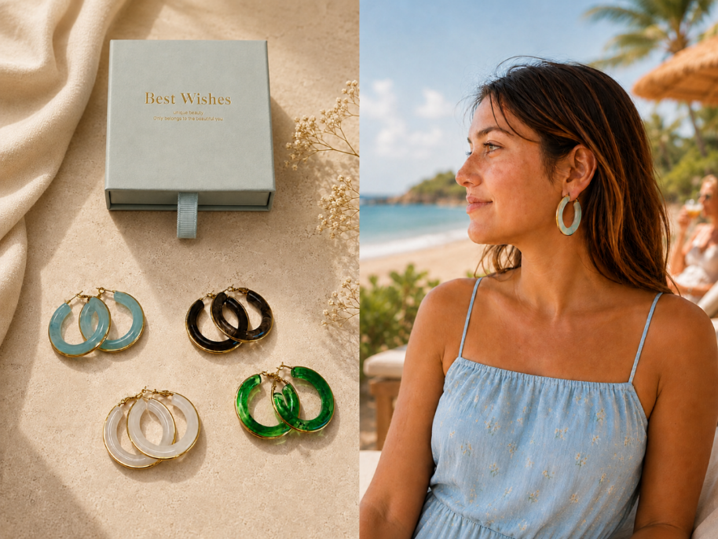
“Summer Jelly” Set Set Includes: 20 Pcs Total，4 Styles × 5 Pcs Each Retail Opportunity: Suggested Retail Price：$13.99–$19.99 per piece Your Wholesale Cost：$2.6–$3.4 per piece Materials: 5-Layer 18K Premium Plating Waterproof & Sweat-proof Occasions: Workdays, Dates, and Parties Vacation Packaging: Chic gift box Best For: Boutique display / Charm bar add-on / Gift corner / Clothing store add-on

Slide 9
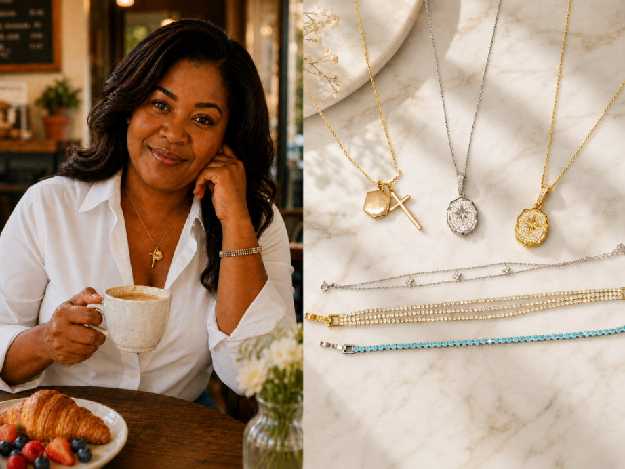
“Chain Love”Set Set Includes: 30 Pcs Total，6 Styles × 5 Pcs Each Retail Opportunity: Suggested Retail Price：$13.99–$24.99 per piece Your Wholesale Cost：$2.8–$3.8 per piece Materials: 5-Layer 18K Premium Plating 5A Cubic Zirconia & Hypoallergenic Waterproof & Sweat-proof Adjustable Size: Bracelet: 7.1" base + 0.4" extender Necklace: 15"-17" Occasions: Day-to-Night Styling Packaging: Chic gift box

Slide 10
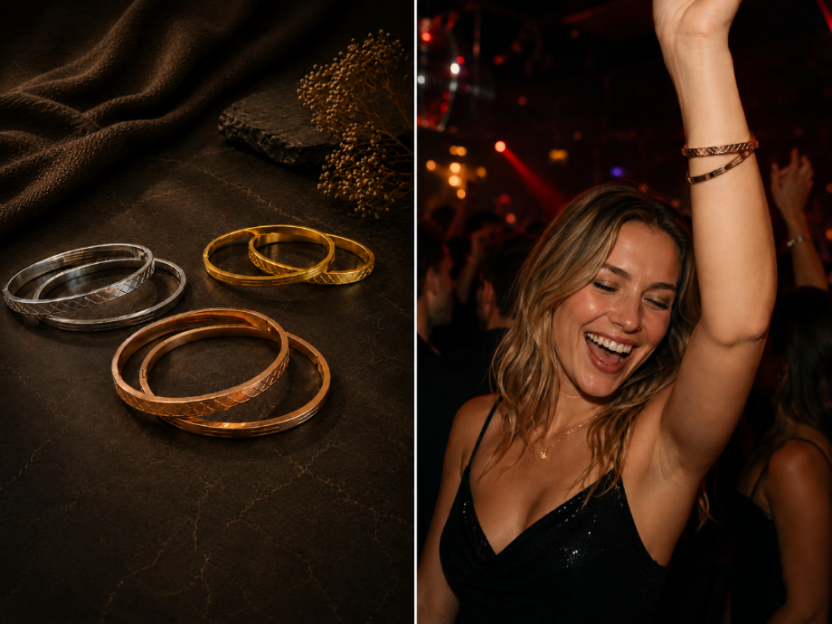
“Modern Muse“ Set Set Includes: 30 Pcs Total，6 Styles × 5 Pcs Each Retail Opportunity: Suggested Retail Price：$13.99–$24.99 per piece Your Wholesale Cost：$2.8–$3.5 per piece Materials: Medical Grade Stainless Steel Waterproof & Sweat-proof Adjustable Size: Bracelet: Fits wrists 5.5" to 7.5" Occasions: Night Style Metal Style Packaging: Chic gift box

Slide 11
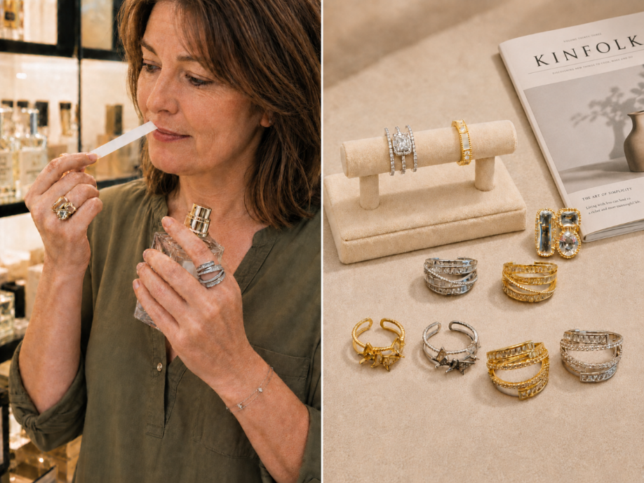
“Orbit Glow“ Set Set Includes: 30 Pcs Total 6 Styles × 3 Pcs Each + 3 Styles × 4 Pcs Each Retail Opportunity: Suggested Retail Price：$15.99–$29.99 per piece Your Wholesale Cost：$3.1–$4.0 per piece Materials: 5-Layer 18K Premium Plating 5A Cubic Zirconia & Hypoallergenic Waterproof & Sweat-proof Adjustable Size: Rings: US 6-8 Open Ring Fit Occasions: Day-to-Night Styling & Chic gift box Best For: Boutique display / Charm bar add-on / Gift corner / Clothing store add-on

Slide 12
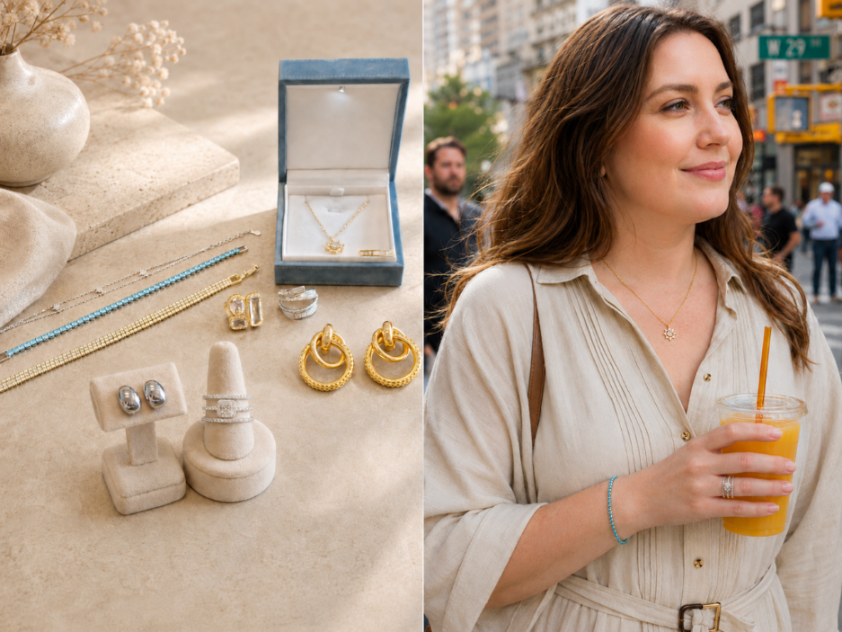
“Daydream“ Set Set Includes: 50 Pcs Total，10 Styles × 5 Pcs Each Retail Opportunity: Suggested Retail Price：$15.99–$29.99 per piece Your Wholesale Cost：$3.1–$4.0 per piece Materials: 5-Layer 18K Premium Plating 5A Cubic Zirconia & Hypoallergenic Waterproof & Sweat-proof Adjustable Size: Rings: US 6-8 Open Ring Fit Bracelet: 6.5"+1" Extender Necklace: 15"-17" Occasions: Day-to-Night Styling & Casual Style Packaging: Chic gift box

Slide 13
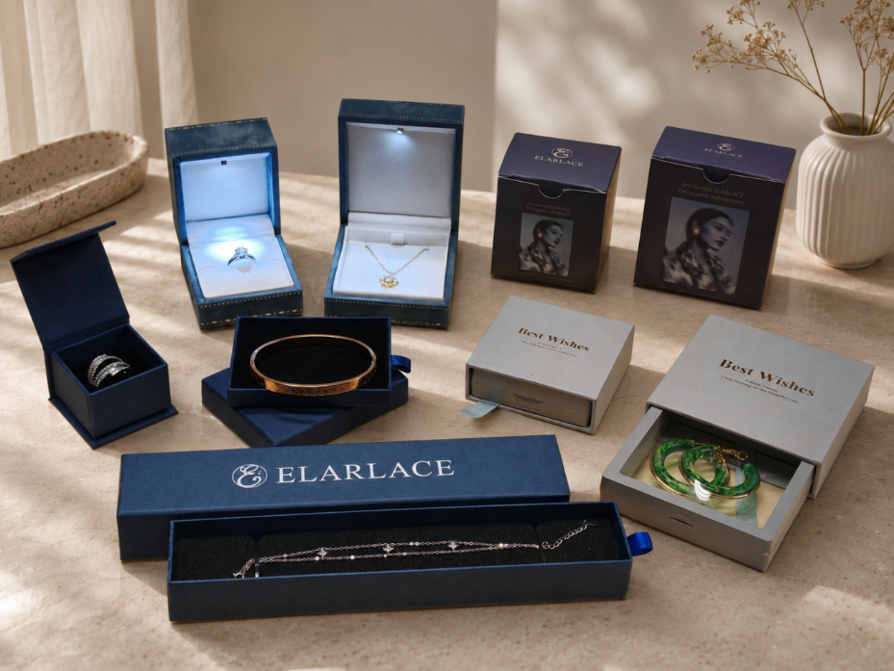
📦 Retail-Ready Packaging: Zero Packaging Costs: Every item comes with its own premium gift box—ready for immediate retail display with zero extra investment. 100% Eco-Friendly: Crafted entirely from sustainably sourced materials to meet modern green consumer standards. Higher Perceived Value: Beautiful unboxing experience to help you maximize your retail margins.

Slide 14
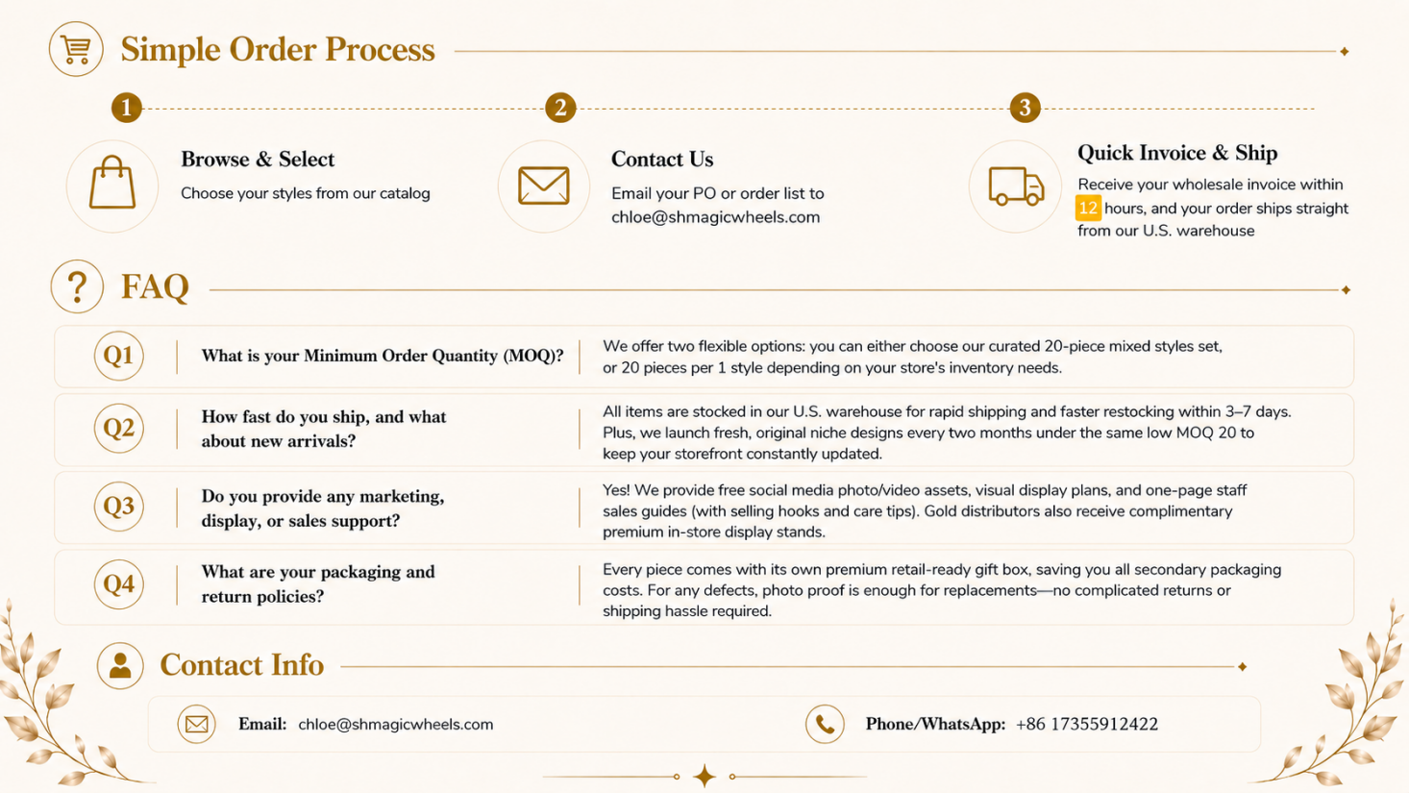

Slide 15
